Slide 1
Microsoft Azure Workshop
Welcome
David.Griswtood@microsoft.com Lawrence.Gripper@microsoft.com
Jamie.Dalton@microsoft.com
Bianca Furtuna bifurt@microsoft.com

Slide 2
Agenda
9:30am Registration opens
10am Workshop starts, with breaks for coffee and lunch
2pm Networking and informal one to one discussions
3pm Machine Learning Workshop
4pm Close

Slide 3
Microsoft Azure
The cloud platform
built for business and
innovation

Slide 4

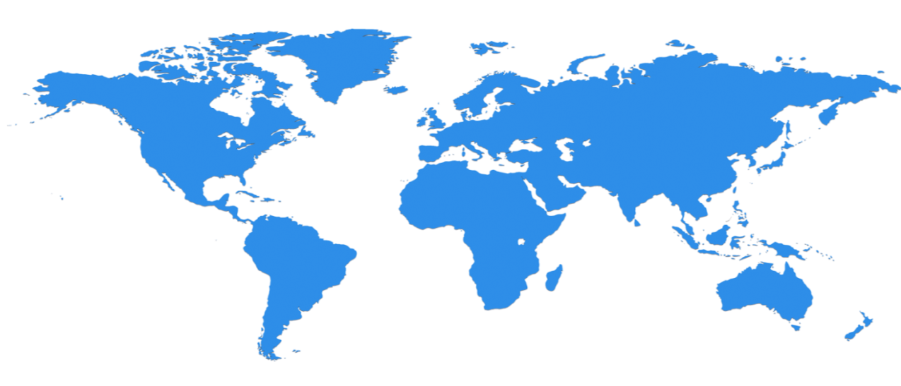

Huge infrastructure scale is the enabler
24 Regions Worldwide, 22 ONLINE…huge capacity around the world…growing every year
UK
North Central US
Illinois
Germany
North Europe
Ireland
West Europe
Netherlands
Central US
Iowa
Canada Central
Toronto
Canada East
Quebec City
US Gov
Iowa
China North *
Beijing
China South *
Shanghai
Japan East
Saitama
West US
California
East US
Virginia
India Central
Pune
Japan West
Osaka
South Central US
Texas
East US 2
Virginia
US Gov
Virginia
India South
Chennai
India West
Mumbai
East Asia
Hong Kong
SE Asia
Singapore
Australia East
New South Wales
Brazil South
Sao Paulo
Australia South East
Victoria
100+ datacenters
Top 3 networks in the world
2x AWS, 6x Google DC Regions
G Series – Largest VM in World, 32 cores, 448GB Ram, SSD…
Operational
Announced/Not Operational
* Operated by 21Vianet

Slide 5
Azure momentum
~100,000
New Azure customer subscriptions/month
20 Million
SQL database hours used every day
>50 Trillion
Storage objects in Azure
>5 Trillion
Storage transactions every month
425 Million
Azure Active Directory Users
60 Billion
Hits to Websites run on Azure Web App Service
57%
Of Fortune 500 Companies use Microsoft Azure
1 Trillion
Messages delivered every month with Event Hubs

Slide 6





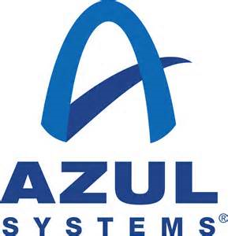



















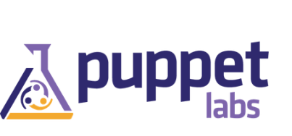

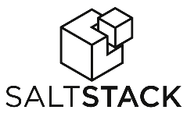



Azure is an Open Cloud
Integrated
Ecosystem Provided
Languages, Dev Tools & App Containers
Bring your own
CMS & Apps
Dozens of .NET & PHP CMS and Web applications
Devices
Via HTMl/JS, cross-platform and native
DocDB
DataStax
Databases
libcloud
jclouds
Management
Ubuntu
SUSE, OpenSUSE,
OpenLogic CentOS-based
Oracle Linux, CoreOS
Bring
your own
Operating systems

Slide 7































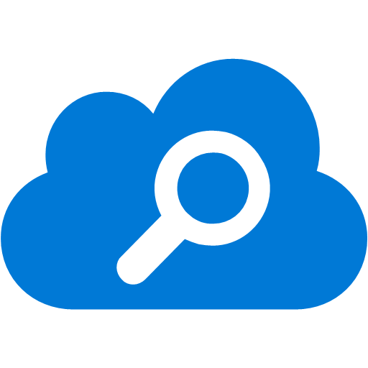




















Platform Services
Security & Management
Compute
Web and Mobile
Developer Services
Hybrid
Operations
Cloud
Services
Service
Fabric
Web Apps
API
Apps
API
Management
Visual Studio
Azure SDK
Portal
Azure AD
Connect Health
Batch
Remote App
Mobile
Apps
Logic
Apps
Notification
Hubs
Team Project
Application
Insights
Active
Directory
AD Privileged
Identity
Management
Multi-Factor
Authentication
Integration
Analytics & IoT
Data
Backup
Storage
Queues
Biztalk
Services
Automation
HDInsight
Machine
Learning
SQL
Database
SQL Data
Warehouse
Operational
Insights
Hybrid
Connections
Service
Bus
Key Vault
Data
Factory
IoT and Event
Hubs
Redis
Cache
Search
Import/Export
Store /
Marketplace
Media & CDN
Site
Recovery
Stream
Analytics
Mobile
Engagement
DocumentDB
Tables
VM Image Gallery
& VM Depot
Media
Services
Content Delivery
Network (CDN)
StorSimple
Infrastructure Services
Compute
Storage
Networking
Virtual Machines
Containers
BLOB Storage
Azure Files
Premium Storage
Virtual Network
Load Balancer
DNS
Express
Route
Traffic Manager
VPN Gateway
Application Gateway
Datacenter Infrastructure (24 Regions, 19 Online)

Slide 8







Analytics and IoT Transform data into intelligent action
Information Management
Big Data Stores
Machine Learning and Analytics
Dashboards and Visualizations
Business apps
Power BI
Azure
Data Factory
Azure
Machine Learning
Personal Digital Assistant
Azure
Data Lake store
Cortana
Azure Data Lake analytics service
People
Custom apps
Azure
Data Catalog
Perceptual Intelligence
Azure HDInsight
(Hadoop and Spark)
Face, vision
Azure
SQL Data Warehouse
Speech, text
Azure
IoT Hub
Azure
Stream Analytics
Business Scenarios
Sensors and devices
Recommendations,
customer churn,
forecasting, etc.
Automated Systems
DATA
INTELLIGENCE
ACTION

Slide 9
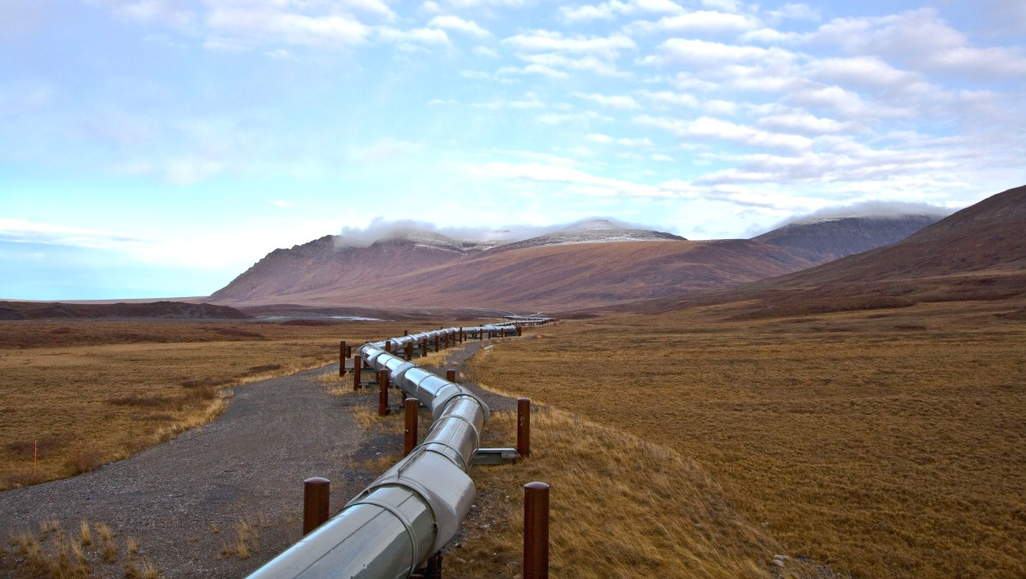


“The more data we have, the more we can learn and put together algorithms to predict problems. It’s about taking information to make systems even more efficient and productive.”
DOUG WEBER
BUSINESS MANAGER,
REMOTE APPLICATION MONITORING
ROCKWELL AUTOMATION
Notes:
Slide goal:
Provide a real-world example of a customer developing an IoT solution
Key points:
Rockwell Automation is an industrial automation company from Milwaukee, WI
Developed a solution that enables petroleum industry customers to monitor their expensive capital assets and provide near-real-time insight into the operation of machinery (often in remote, isolated regions)
This allows customers to reduce downtime and maintenance of assets, increasing productivity
From this original solution, Rockwell was able to expand their asset monitoring and management capabilities by incorporating big-data analytics tools from Microsoft Azure, allowing them to analyze massive amounts of raw telemetry data and manage complex data interactions across multiple systems
This provides their customers with advanced analytics that provide actionable information to inform their business decision-making
Presenter guidance:
Unless your audience is very IT-savvy, keep the information at a high-level
Potentially frame this as:
Problem: For petroleum industry customers, managing and operating their machinery and other assets is a constant challenge. These machines are expensive, remote, and often hard to get to. Unexpected downtime and increased maintenance of assets for Rockwell’s petroleum industry customers was impacting their productivity and increasing costs over time
Solution: Rockwell develop an IoT solution that provided remote asset monitoring and management capabilities
Customer impact: Rockwell’s customers were able to reduce downtime and maintenance of assets, increasing productivity
Partner outlook: Rockwell was able to expand their asset monitoring and management capabilities by incorporating big-data tools from Microsoft Azure, allowing them with massive amounts of data and manage complex interactions across customers – enabling them to provide their customers with new and improved services
For customers who want more information, use the “Watch Video” button in the bottom left-hand corner to show them the video case study
Talk track:
An industrial automation company based out of Milwaukee, Wisconsin, Rockwell Automation is using IoT to help customers transform their operations within the petroleum industry. Their solution monitors expensive capital assets, and provides a near-real-time view of the operation of machinery in remote, isolated regions. Because Rockwell is now able to remote monitor assets worldwide, they are able to reduce costly downtime and maintenance of assets, and increase productivity. As a result of Rockwell’s end-to-end approach, customers are changing the way they manage their entire oil and gas supply chain.
And Rockwell didn’t stop there. They soon expanded on the asset monitoring and management capabilities of their solution to include a broad data strategy that incorporates big-data analytics tools, including Azure HDInsight and Azure Data Factory, to allow them to manage complex data interactions across multiple systems and analyze massive amounts of raw telemetry data. For customers, this advanced analytics feature brings actionable, predictive information that facilitates and informs business decision-making.
Harnessing the potential of the data collected from the ocean floor to the gas pump on the corner, Rockwell Automation is using IoT to light up traditional pump, transport and metering equipment with cloud-connected sensors, and is providing customers with new forms of insight and value that even they didn’t expect at the time of developing the solution. It’s all about capturing new data streams, and turning that data into insights and action.
<Click>

Slide 10



Coca-Cola coolers get an extra dose of “cool” thanks to IoT
CHALLENGE
SOLUTION
BENEFITS
Coca-Cola Amatil (CCA) is a leading bottler and distributor of beverages across six countries in the Asia-Pacific region, with approximately 14,900 employees, 270 million consumers, and a large portfolio of soft drink brands and premium alcoholic beverages. To stay ahead of the competition, CCA wanted to create a differentiated brand experience for consumers.
CCA teamed with TKM9 to create a solution that integrates interactive digital signage on refrigerated beverage coolers with mobile phones and a backend system used for analytics and real-time updates. The solution connects coolers equipped with Windows Embedded touchscreens and Kinect for Windows technology to an analytics application running in the cloud on the Microsoft Azure platform.
Improves competitive advantage by delivering dynamic, relevant content
Boosts sales 12 percent in grocery and up to 20 percent in off-premise locations, with a 120 percent lift in the off-premise channel when combined with discount offer
Optimizes implementation with flexible, scalable solution
“We wanted an interactive interface from the consumer’s perspective. It’s not just about delivering digital content, it’s about doing it in a more targeted and relevant way.”
Stuart Port Manager of Frozen Beverages Strategy
COCA-COLA AMATIL
Notes:
Coca-Cola Amatil (CCA) is leading beverage bottler and distributor in the Asia-Pacific Region and one of the largest Coca-Cola bottlers worldwide with 14,900 employees, 270 million consumers, and a portfolio of popular soft drink and premium spirits brands.
To create a differentiated brand experience, CCA worked with TKM9—a digital marketing agency—to create an intelligent system based on Microsoft technology including Windows Embedded, Kinect for Windows, and the Microsoft Azure platform. The solution connects interactive digital signage on refrigerated beverage coolers with mobile phones, cloud-based analytics and content software, and social media.
By creating an immersive experience with technology from Microsoft and TKM9, CCA is gaining a stronger competitive advantage, better customer relationships, and more scalable infrastructure.
Improves competitive advantage by delivering dynamic, relevant content
Boosts sales an average of 12 percent overall, and up to 120 percent with discount offer
Optimizes implementation with flexible, scalable solution
*Please click the hyperlink on the company name in the slide to go to the full case study/article. If the name is not hyperlinked, no additional materials are available.
Microsoft Azure
Azure Cloud Services
Azure Mobile Services
Azure SQL Database
Kinect for Windows
Windows Embedded Standard

Slide 11


The Internet of Things gives the world’s cities a major lift
THYSSENKRUPP ELEVATOR VIDEO
CHALLENGE
SOLUTION
BENEFITS
Leading global manufacturer ThyssenKrupp Elevator maintains more than elevators worldwide, including those at some of the1.1 million world’s most iconic buildings. ThyssenKrupp wanted to better compete in their industry by offering dramatically increased uptime, taking preventative maintenance a step further to predictive and even pre-emptive service.
ThyssenKrupp teamed up with Microsoft and CGI to create a connected, intelligent asset monitoring system based on Microsoft Azure Intelligent Systems Service, Power BI for Office 365, and Microsoft Azure Machine Learning. The solution connects thousands of sensors and systems in its elevators to the cloud and draws this data into a dashboard available on PCs and mobile devices for a real-time view of key performance indicators.
.
Increases reliability through predictive maintenance and rapid, remote diagnostic capabilities
Reduces costs for ThyssenKrupp and their customers
Rich, real-time data visualization
Data continually feeds into dynamic predictive models
“We wanted to go beyond the industry standard of preventative maintenance, to offer predictive and even preemptive maintenance.”
Andreas Schierenbeck CEO
Notes:
ThyssenKrupp Elevator - a leading global provider of elevators - has 1.1 million machines operating in 150 countries, 49,000 employees, and reported sales of EUR €6.2 billion (US $8.4 billion) in 2013. With installations in iconic buildings worldwide, ThyssenKrupp wanted to further improve its competitive advantage by increasing elevator reliability and uptime.
With help from Microsoft partner CGI, TKE created an intelligent, cloud-based solution based on Microsoft Azure Intelligent Systems Services, Power BI for Office 365, and Microsoft Azure Machine Learning that automatically collects, analyzes, and visualizes data from thousands of sensors and systems to enable real-time, actionable insight into current performance as well as predictive maintenance. And with Power BI connected to Microsoft Azure ISS, field techs using mobile apps and control center analysts working with a cloud-based dashboard can access and visualize the same data simultaneously for collaborative trouble-shooting.
Increases reliability and reduces costs through predictive maintenance and rapid, remote diagnostic capabilities
Rich, real-time data visualization
Data continually feeds into dynamic predictive models
Two-way flow of data enables diagnostics mode and remote elevator commands
*Please click the hyperlink on the company name in the slide to view customer content. If the name is not hyperlinked, no additional materials are available.
Microsoft Azure
Azure Machine Learning
Power BI for Office 365

Slide 12
Azure IoT Solutions
Well known fast food chain using Azure to monitor temperature of deep fat fryers
World leading jet engine manufacturer monitoring engines to predict failure
Biggest automotive manufactures tracking car telemetry
. . . .

